Slide 1
International Motors
Enterprise Order Management Platform
Advanced AI-driven business intelligence with optimization support
30 June 2025

Slide 2
Order Management Use Case
MVP demo storyline:
Identify current‑month orders and completed revenue
Expose top 5 delay causes + $ impact
Show AI‑generated priority queue (pull‑forward candidates)
PoC focus: Severe‑segment orders → AI order scheduling & financial optimization

Slide 3
Synthetic Dataset Snapshot
60,157 order lines | Jun 2023 – May 2025
75 customers · 3 product families (Trucks 58 %, Buses 16 %, Powertrains 26 %)
101 columns – production, finance, engineering, supply‑chain, quality
15 % overall delay rate with tier differentiation (Platinum < 70 % of others)
5.6 % cancellations, stage‑based revenue impact embedded

Slide 4
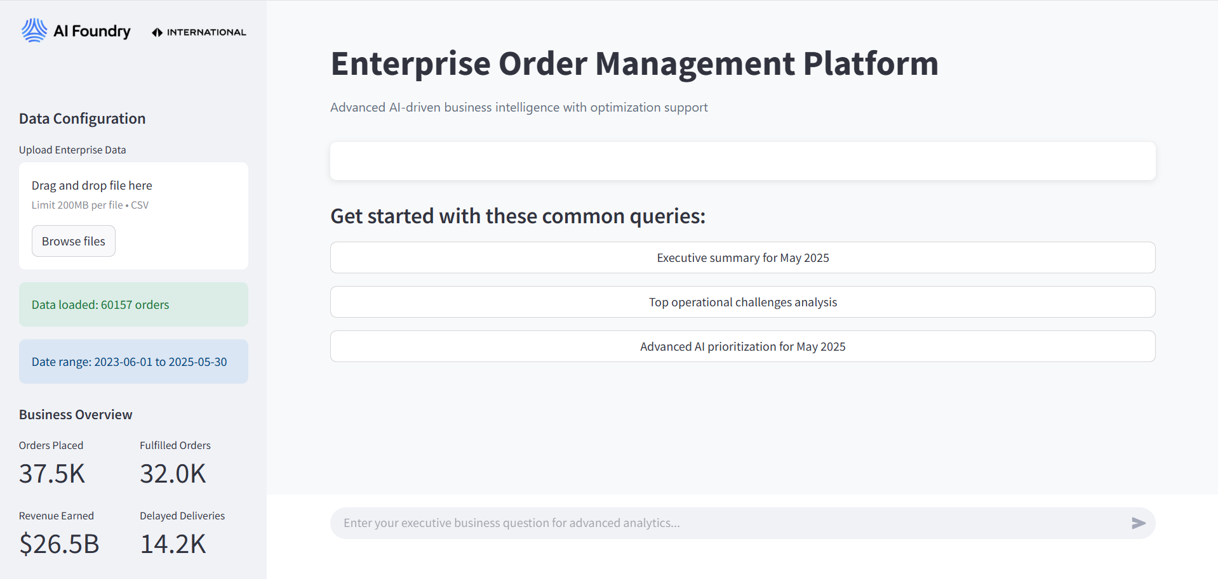

Slide 5
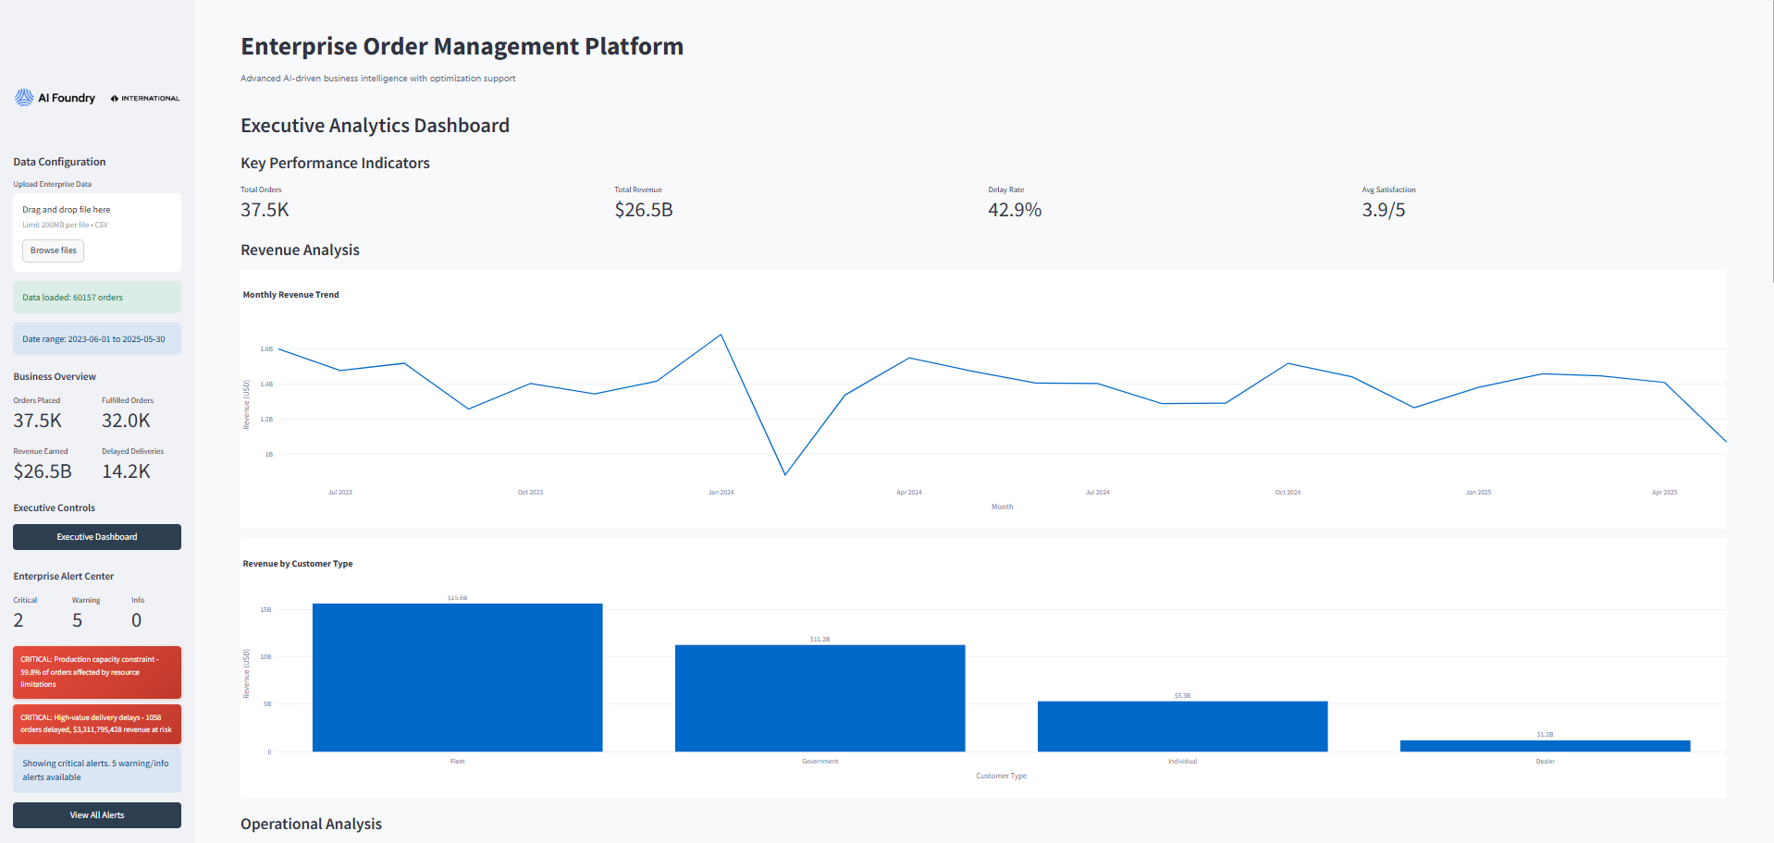

Slide 6
